Slide 1
ICBHR
An Improved Convolutional Neural Network for Bangla Handwriting Recognition

Slide 2
Team Details
Presented By
Md. Imran Nazir | 19202103248
Tunazzinur Rahman Kabbo | 19202103268
Md. Zobayer Hasan Nayem | 19202103274
Afsana Akter | 19202103295
Afia Anzum Joati | 19202103409
Supervised By
Mijanur Rahman Assistant Professor Department of CSE, BUBT

Slide 3
Table of contents
01
02
03
04
05
06
07
08
09
10
Abstract
Introduction
Purpose of Study
Background
Literature
Review
Methodology
Implementation
Experimental
Result
Limitations
Future Work

Slide 4
01
Abstract

Slide 5
1 | Developed a system to accurately identify Bangla handwritten characters, numerals and modifiers
2 | Utilized a deep learning model based on CNN
3 | Our single model which is applied on three different datasets, showed contemporary results
4 | Achieved accuracy: NumtaDB - 99.7% CMATERdb - 97.2% IUBMCdb - 99%

Slide 6
02
Introduction

Slide 7
Bangla is spoken by around 250 million people worldwide (7th most popular language globally)
Compared to other languages there's less research on Bangla
Challenges include shape variation, complex arrangement, and character similarity
Developed a highly accurate model for recognizing Bengali characters, numbers, and modifiers

Slide 8
03
Purpose of
Study

Slide 9
Advancing Bangla Handwritten Character Recognition
Improving Language-related Initiatives
Addressing Real-world Challenge

Slide 10
04
Background

Slide 11
Complex bengali script with diverse characters and unique features
Availability of diverse datasets
Digitizes documents, processes forms and aids data entry
Significant research and development

Slide 12
05
Literature
Review

Slide 13
Author | Type | Model | Dataset | Accuracy
AKM Shahariar Azad Rabby [8] | Bangla Handwriting | SVM, MLP classifier | Ekushnet, CAMTERdb | 96.90% 95%
Bishwajit [17] | Alphabets | Deep CNN | Banglalekha-isolated | 91.23%
I Khandokar [19] | Bangla characters | CNN | Images from NIST | 92.91%
Xu [23] | Bangla characters | Bayesian network | Own dataset | 87.5%
Md Mahbubar Rahman [18] | Bangla characters | CNN | Own dataset | 85.96%

Slide 14
06
Methodology

Slide 15
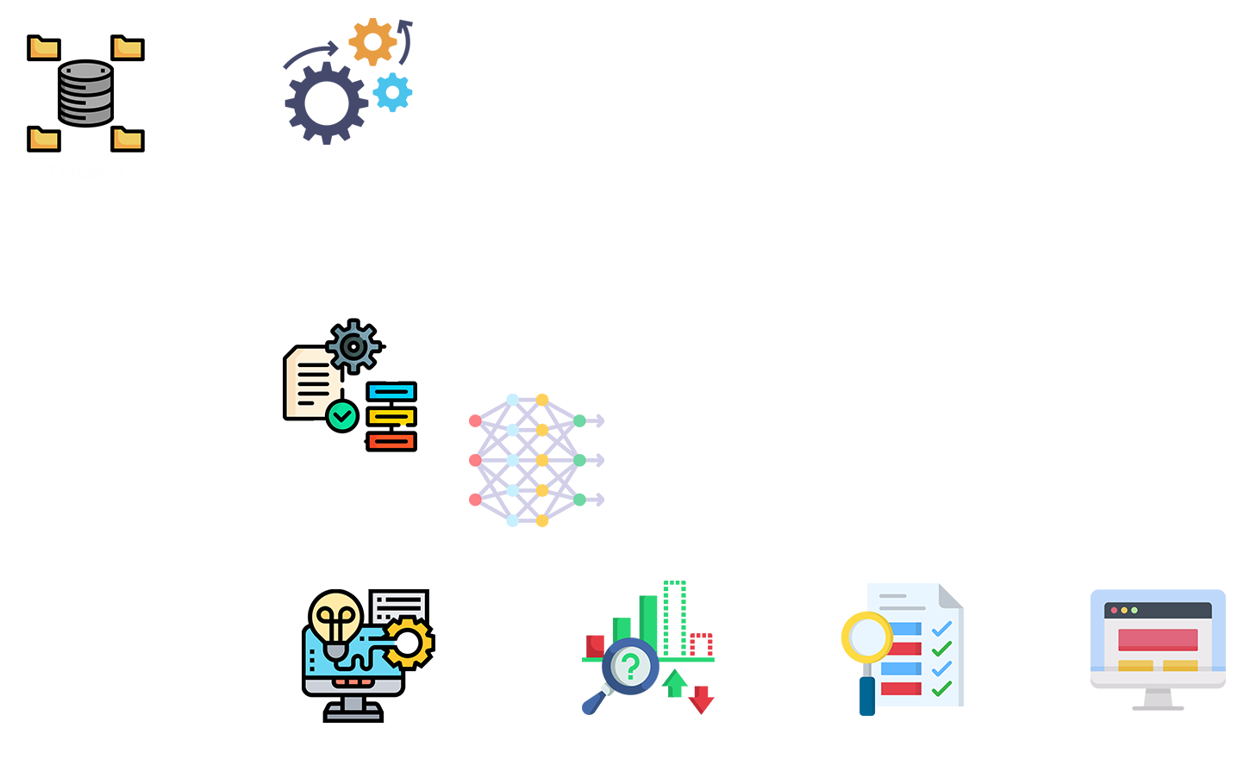
Data Collection
Data Analysis
Proposed Model

Slide 16
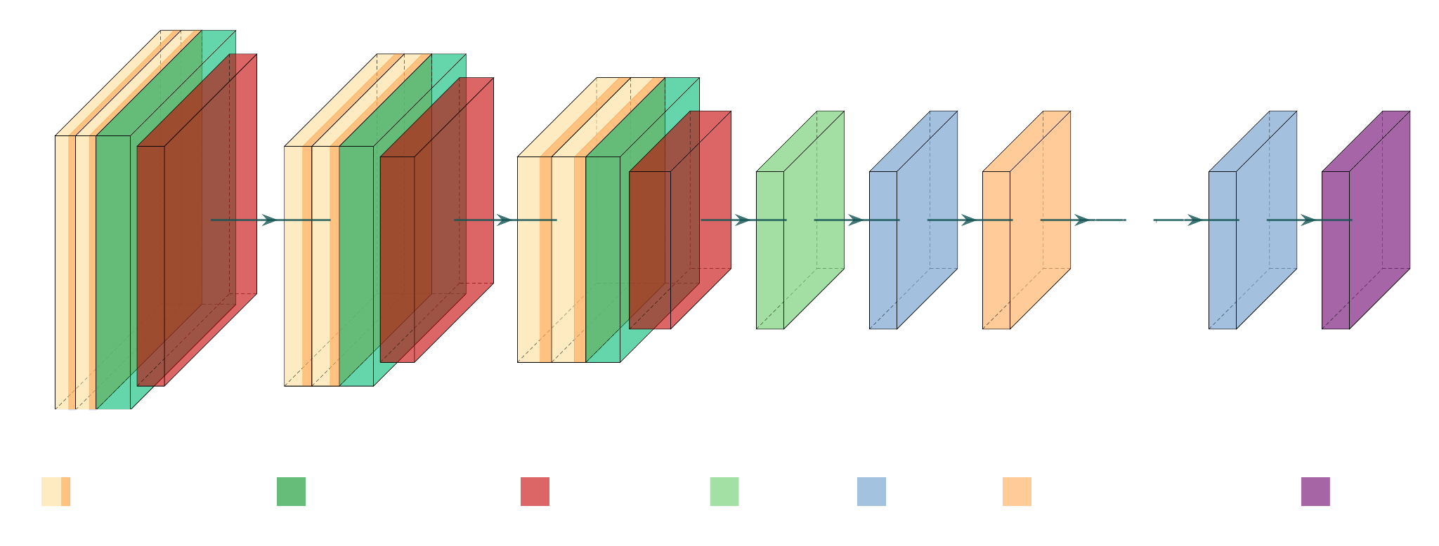
Dataset Name | No of Total Images
CMATERdb 3.1.2 | 15000 characters
NumtaDB | 85,000+ digits
IUBMCdb | 7909 Modifiers

Slide 17
07
Implementation

Slide 18
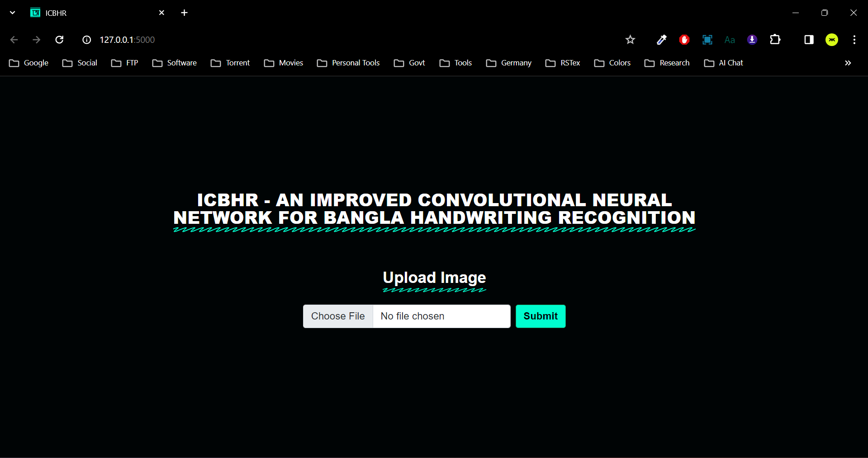
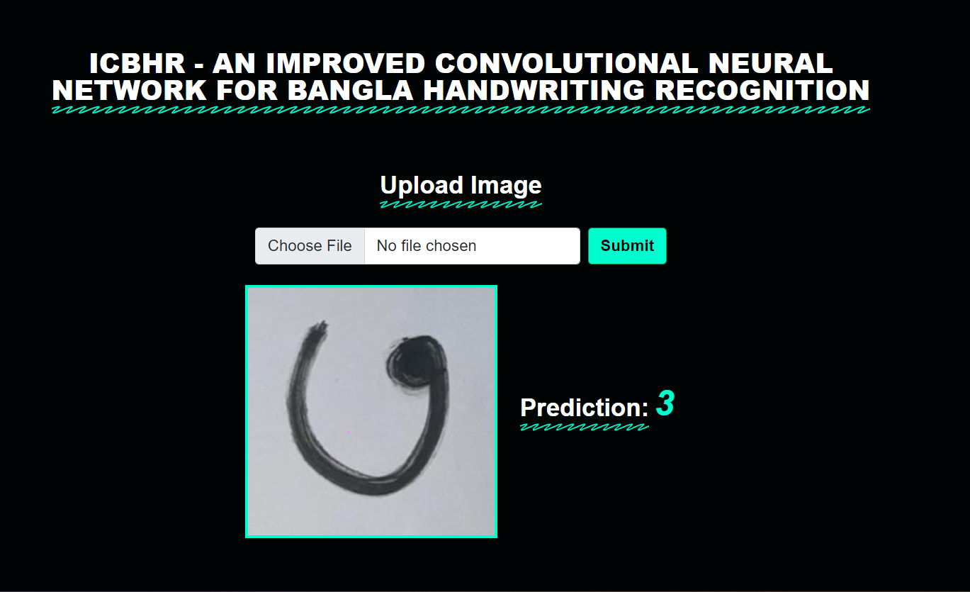
Unlock the power of Bangla handwriting recognition in real-time with our cutting edge model

Slide 19
08
Experimental Result

Slide 20
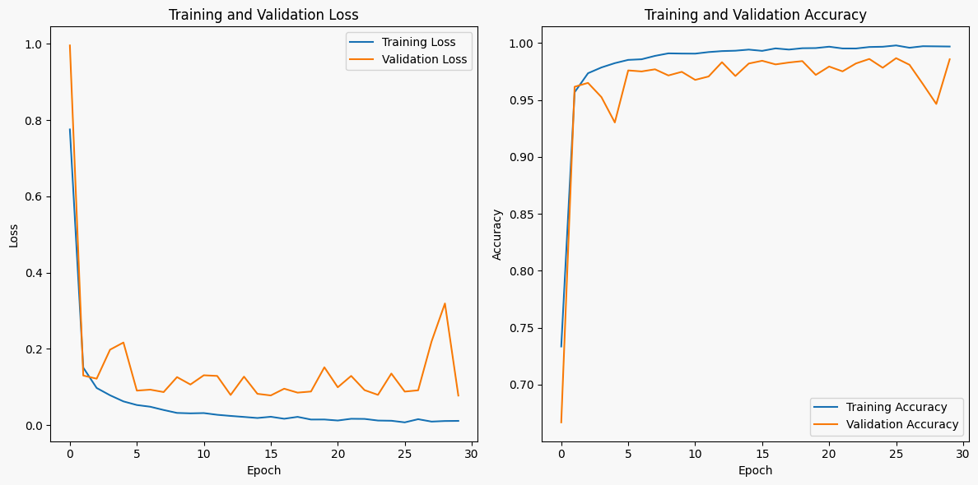
Dataset Name | Accuracy | Validation Accuracy
CMATERdb 3.1.2 | 97.2% | 96.0%
NumtaDB | 99.7% | 98.6%
IUBMCdb | 99.0%

Slide 21
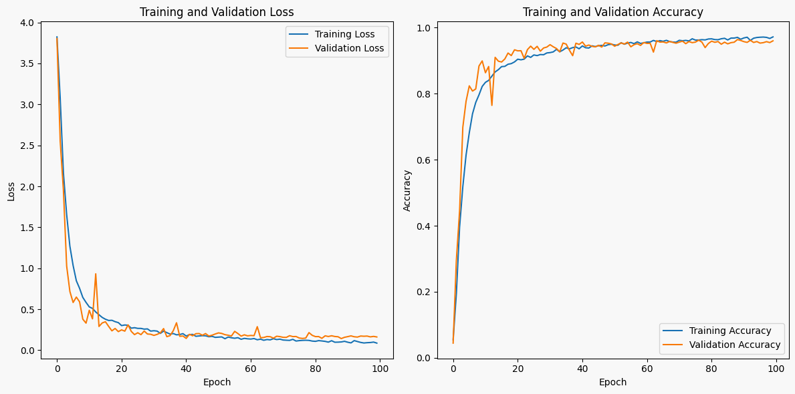
Dataset Name | Accuracy | Validation Accuracy
CMATERdb 3.1.2 | 97.2% | 96.0%
NumtaDB | 99.7% | 98.6%
IUBMCdb | 99.0%

Slide 22
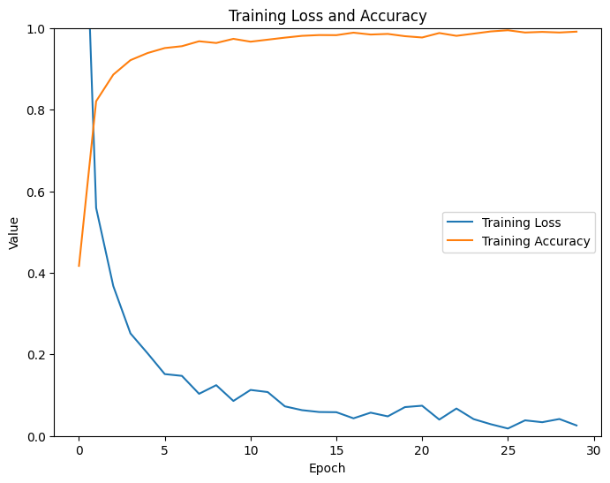
Dataset Name | Accuracy | Validation Accuracy
CMATERdb 3.1.2 | 97.2% | 96.0%
NumtaDB | 99.7% | 98.6%
IUBMCdb | 99.0%

Slide 23
09
Limitations

Slide 24
A
Different handwriting styles
Limitations
B
Complex character and shape
C
Poor image quality

Slide 25
10
Future Work

Slide 26
Will include complex Bangla character including compound character and “matra”
Will try to extract individual character as well as word from a sentence

Slide 27
Thank You!
Any Questions?

